Slide 1
Neural Network: A Brief Overview
Performance in Analytical Models CS. 6645

Slide 2
Outline
Introduction
Background
How the human brain works
A Neuron Model
A Simple Neuron
Pattern Recognition example
A Complicated Perceptron

Slide 3
Outline Continued
Different types of Neural Networks
Network Layers and Structure
Training a Neural Network
Learning process
Neural Networks in use
Use of Neural Networks in C.A.I.S. project
Conclusion

Slide 4
Introduction
What are Neural Networks?
Neural networks are a new method of programming computers.
They are exceptionally good at performing pattern recognition and other tasks that are very difficult to program using conventional techniques.
Programs that employ neural nets are also capable of learning on their own and adapting to changing conditions.

Slide 5
Background
An Artificial Neural Network (ANN) is an information processing paradigm that is inspired by the biological nervous systems, such as the human brain’s information processing mechanism.
The key element of this paradigm is the novel structure of the information processing system. It is composed of a large number of highly interconnected processing elements (neurons) working in unison to solve specific problems. NNs, like people, learn by example.
An NN is configured for a specific application, such as pattern recognition or data classification, through a learning process. Learning in biological systems involves adjustments to the synaptic connections that exist between the neurons. This is true of NNs as well.

Slide 6
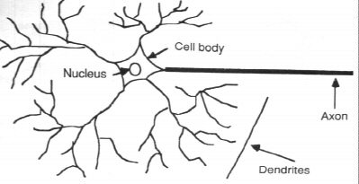
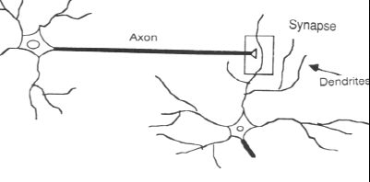
How the Human Brain learns
In the human brain, a typical neuron collects signals from others through a host of fine structures called dendrites.
The neuron sends out spikes of electrical activity through a long, thin stand known as an axon, which splits into thousands of branches.
At the end of each branch, a structure called a synapse converts the activity from the axon into electrical effects that inhibit or excite activity in the connected neurons.

Slide 7
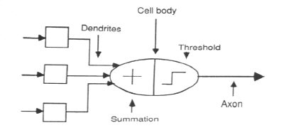
A Neuron Model
When a neuron receives excitatory input that is sufficiently large compared with its inhibitory input, it sends a spike of electrical activity down its axon. Learning occurs by changing the effectiveness of the synapses so that the influence of one neuron on another changes.
We conduct these neural networks by first trying to deduce the essential features of neurons and their interconnections.
We then typically program a computer to simulate these features.

Slide 8
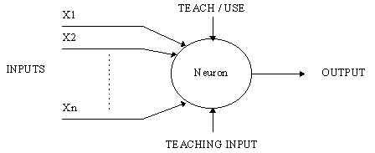
A Simple Neuron
An artificial neuron is a device with many inputs and one output.
The neuron has two modes of operation;
the training mode and
the using mode.

Slide 9
A Simple Neuron (Cont.)
In the training mode, the neuron can be trained to fire (or not), for particular input patterns.
In the using mode, when a taught input pattern is detected at the input, its associated output becomes the current output. If the input pattern does not belong in the taught list of input patterns, the firing rule is used to determine whether to fire or not.
The firing rule is an important concept in neural networks and accounts for their high flexibility. A firing rule determines how one calculates whether a neuron should fire for any input pattern. It relates to all the input patterns, not only the ones on which the node was trained on previously.

Slide 10
Pattern Recognition
An important application of neural networks is pattern recognition. Pattern recognition can be implemented by using a feed-forward neural network that has been trained accordingly.
During training, the network is trained to associate outputs with input patterns.
When the network is used, it identifies the input pattern and tries to output the associated output pattern.
The power of neural networks comes to life when a pattern that has no output associated with it, is given as an input.
In this case, the network gives the output that corresponds to a taught input pattern that is least different from the given pattern.

Slide 11

Pattern Recognition (cont.)
Suppose a network is trained to recognize the patterns T and H. The associated patterns are all black and all white respectively as shown above.

Slide 12
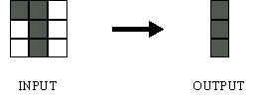
Pattern Recognition (cont.)
Since the input pattern looks more like a ‘T’, when the network classifies it, it sees the input closely resembling ‘T’ and outputs the pattern that represents a ‘T’.

Slide 13
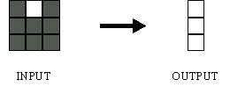
Pattern Recognition (cont.)
The input pattern here closely resembles ‘H’ with a slight difference. The network in this case classifies it as an ‘H’ and outputs the pattern representing an ‘H’.

Slide 14
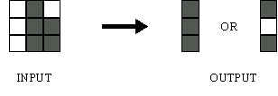
Pattern Recognition (cont.)
Here the top row is 2 errors away from a ‘T’ and 3 errors away from an H. So the top output is a black.
The middle row is 1 error away from both T and H, so the output is random.
The bottom row is 1 error away from T and 2 away from H. Therefore the output is black.
Since the input resembles a ‘T’ more than an ‘H’ the output of the network is in favor of a ‘T’.

Slide 15
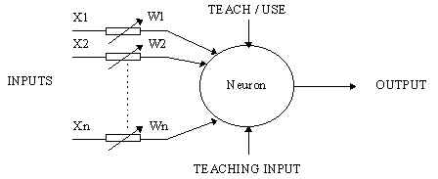
A Complicated Perceptron
A more sophisticated Neuron is know as the McCulloch and Pitts model (MCP).
The difference is that in the MCP model, the inputs are weighted and the effect that each input has at decision making, is dependent on the weight of the particular input.
The weight of the input is a number which is multiplied with the input to give the weighted input.

Slide 16
A Complicated Perceptron (cont.)
The weighted inputs are then added together and if they exceed a pre-set threshold value, the perceptron / neuron fires.
Otherwise it will not fire and the inputs tied to that perceptron will not have any effect on the decision making.
In mathematical terms, the neuron fires if and only if;
X1W1 + X2W2 + X3W3 + ... > T

Slide 17
A Complicated Perceptron
The MCP neuron has the ability to adapt to a particular situation by changing its weights and/or threshold.
Various algorithms exist that cause the neuron to 'adapt'; the most used ones are the Delta rule and the back error propagation.

Slide 18
Different types of Neural Networks
Feed-forward networks
Feed-forward NNs allow signals to travel one way only; from input to output. There is no feedback (loops) i.e. the output of any layer does not affect that same layer.
Feed-forward NNs tend to be straight forward networks that associate inputs with outputs. They are extensively used in pattern recognition.
This type of organization is also referred to as bottom-up or top-down.

Slide 19
Continued
Feedback networks
Feedback networks can have signals traveling in both directions by introducing loops in the network.
Feedback networks are dynamic; their 'state' is changing continuously until they reach an equilibrium point.
They remain at the equilibrium point until the input changes and a new equilibrium needs to be found.
Feedback architectures are also referred to as interactive or recurrent, although the latter term is often used to denote feedback connections in single-layer organizations.

Slide 20
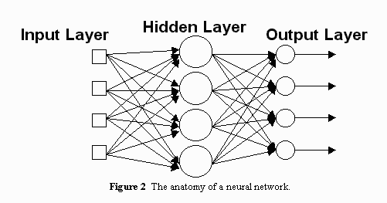
Diagram of an NN
Fig: A simple Neural Network

Slide 21
Network Layers
Input Layer - The activity of the input units represents the raw information that is fed into the network.
Hidden Layer - The activity of each hidden unit is determined by the activities of the input units and the weights on the connections between the input and the hidden units.
Output Layer - The behavior of the output units depends on the activity of the hidden units and the weights between the hidden and output units.

Slide 22
Continued
This simple type of network is interesting because the hidden units are free to construct their own representations of the input.
The weights between the input and hidden units determine when each hidden unit is active, and so by modifying these weights, a hidden unit can choose what it represents.

Slide 23
Network Structure
The number of layers and of neurons depend on the specific task. In practice this issue is solved by trial and error.
Two types of adaptive algorithms can be used:
start from a large network and successively remove some neurons and links until network performance degrades.
begin with a small network and introduce new neurons until performance is satisfactory.

Slide 24
Network Parameters
How are the weights initialized?
How many hidden layers and how many neurons?
How many examples in the training set?

Slide 25
Weights
In general, initial weights are randomly chosen, with typical values between -1.0 and 1.0 or -0.5 and 0.5.
There are two types of NNs. The first type is known as
Fixed Networks – where the weights are fixed
Adaptive Networks – where the weights are changed to reduce prediction error.

Slide 26
Size of Training Data
Rule of thumb:
the number of training examples should be at least five to ten times the number of weights of the network.
Other rule:
|W|= number of weights
a = expected accuracy on test set

Slide 27
Training Basics
The most basic method of training a neural network is trial and error.
If the network isn't behaving the way it should, change the weighting of a random link by a random amount. If the accuracy of the network declines, undo the change and make a different one.
It takes time, but the trial and error method does produce results.

Slide 28
Training: Backprop algorithm
The Backprop algorithm searches for weight values that minimize the total error of the network over the set of training examples (training set).
Backprop consists of the repeated application of the following two passes:
Forward pass: in this step the network is activated on one example and the error of (each neuron of) the output layer is computed.
Backward pass: in this step the network error is used for updating the weights. Starting at the output layer, the error is propagated backwards through the network, layer by layer. This is done by recursively computing the local gradient of each neuron.

Slide 29
Back Propagation
Back-propagation training algorithm
Backprop adjusts the weights of the NN in order to minimize the network total mean squared error.
Network activation
Forward Step
Error propagation
Backward Step

Slide 30
The Learning Process
The memorization of patterns and the subsequent response of the network can be categorized into two general paradigms:
Associative mapping
Regularity detection

Slide 31
Associative Mapping
Associative mapping a type of NN in which the network learns to produce a particular pattern on the set of input units whenever another particular pattern is applied on the set of input units.
This allows the network to complete a pattern given parts of a pattern that is similar to a previously learned pattern.

Slide 32
Regularity Detection
Regularity detection is a type of NN in which units learn to respond to particular properties of the input patterns. Whereas in associative mapping the network stores the relationships among patterns.
In regularity detection the response of each unit has a particular 'meaning'. This means that the activation of each unit corresponds to different input attributes.

Slide 33
The Learning Process (cont.)
Every neural network possesses knowledge which is contained in the values of the connection weights.
Modifying the knowledge stored in the network as a function of experience implies a learning rule for changing the values of the weights.

Slide 34
The Learning Process (cont.)
Recall: Adaptive networks are NNs that allow the change of weights in its connections.
The learning methods can be classified in two categories:
Supervised Learning
Unsupervised Learning

Slide 35
Supervised Learning
Supervised learning which incorporates an external teacher, so that each output unit is told what its desired response to input signals ought to be.
An important issue concerning supervised learning is the problem of error convergence, ie the minimization of error between the desired and computed unit values.
The aim is to determine a set of weights which minimizes the error. One well-known method, which is common to many learning paradigms is the least mean square (LMS) convergence.

Slide 36
Supervised Learning
In this sort of learning, the human teacher’s experience is used to tell the NN which outputs are correct and which are not.
This does not mean that a human teacher needs to be present at all times, only the correct classifications gathered from the human teacher on a domain needs to be present.
The network then learns from its error, that is, it changes its weight to reduce its prediction error.

Slide 37
Unsupervised Learning
Unsupervised learning uses no external teacher and is based upon only local information. It is also referred to as self-organization, in the sense that it self-organizes data presented to the network and detects their emergent collective properties.
The network is then used to construct clusters of similar patterns.
This is particularly useful is domains were a instances are checked to match previous scenarios. For example, detecting credit card fraud.

Slide 38
Neural Network in Use
Since neural networks are best at identifying patterns or trends
in data, they are well suited for prediction or forecasting
needs including:
sales forecasting
industrial process control
customer research
data validation
risk management
ANN are also used in the following specific paradigms: recognition of speakers in communications; diagnosis of hepatitis; undersea mine detection; texture analysis; three-dimensional object recognition; hand-written word recognition; and facial recognition.

Slide 39
Neural networks in Medicine
Artificial Neural Networks (ANN) are currently a 'hot' research area in medicine and it is believed that they will receive extensive application to biomedical systems in the next few years.
At the moment, the research is mostly on modeling parts of the human body and recognizing diseases from various scans (e.g. cardiograms, CAT scans, ultrasonic scans, etc.).

Slide 40
Continued
Neural networks are ideal in recognizing diseases using scans since there is no need to provide a specific algorithm on how to identify the disease.
Neural networks learn by example so the details of how to recognize the disease are not needed.
What is needed is a set of examples that are representative of all the variations of the disease.
The quantity of examples is not as important as the 'quality'. The examples need to be selected very carefully if the system is to perform reliably and efficiently.

Slide 41
Modeling and Diagnosing the Cardiovascular System
Neural Networks are used experimentally to model the human cardiovascular system.
Diagnosis can be achieved by building a model of the cardiovascular system of an individual and comparing it with the real time physiological measurements taken from the patient.
If this routine is carried out regularly, potential harmful medical conditions can be detected at an early stage and thus make the process of combating the disease much easier.

Slide 42
Continued
A model of an individual's cardiovascular system must mimic the relationship among physiological variables (i.e., heart rate, systolic and diastolic blood pressures, and breathing rate) at different physical activity levels.
If a model is adapted to an individual, then it becomes a model of the physical condition of that individual. The simulator will have to be able to adapt to the features of any individual without the supervision of an expert. This calls for a neural network.

Slide 43
Continued
Another reason that justifies the use of NN technology, is the ability of NNs to provide sensor fusion which is the combining of values from several different sensors.
Sensor fusion enables the NNs to learn complex relationships among the individual sensor values, which would otherwise be lost if the values were individually analyzed.
In medical modeling and diagnosis, this implies that even though each sensor in a set may be sensitive only to a specific physiological variable, NNs are capable of detecting complex medical conditions by fusing the data from the individual biomedical sensors.

Slide 44
Use of Neural Networks in C.A.I.S. Project
In C.A.I.S. Project, a Neural Network implementing supervised learning should be used.
This would allows the system to first predict an output and then compare its output with the gold standard to calculate its error.
By implementing a Neural Network utilizing the Back propagation algorithm, we can assure that the network will be able to reduce its prediction error given the right training examples.

Slide 45
Continued
However, to do this, the network needs to have enough information/ variables to make connection to the diagnosis of different variations of heart murmur.
Simply the signal processed sound may give us an output, but it has the possibility to be error prone.
Hence the network will need to have a supply of contextual data, gathered from experts while training, to make strong and correct predictions.

Slide 46
Disadvantage of Neural Network
The individual relations between the input variables and the output variables are not developed by engineering judgment so that the model tends to be a black box or input/output table without analytical basis.
The sample size has to be large.
Requires lot of trial and error so training can be time consuming.

Slide 47
Conclusion
A Neural Network can be successfully used in the C.A.I.S. project, given that we have access to enough training data.
Since we need it to be highly accurate, we need to carefully gather contextual variables that closely relate to diagnosing heart murmur and its various grades.

